Slide 1

Introduction to Coding Using C#
By Justin Mosier for KGSA’s Computer Club

Slide 2


About Me—Justin Mosier
Live in Denver, Colorado
Originally from Virginia
Graduated with a B.S. in Computer Science
Me and my girlfriend Georgia

Slide 3
My Work Experience
Operations engineer for an IRM (Integrated Risk Management) company
Manage software that runs in AWS (Amazon Web Services) on Windows Servers
Automation of tasks using mostly Windows PowerShell
Previously supported a smaller application and also did application development
Wrote code in C# using and .NET framework
Managed software that runs in Azure on Windows Servers

Slide 4
Resources
Discord
Social platform used for voice and chat messaging, screen sharing.
Quick guide to getting started with Discord: Getting Started – Discord
Discord Server link: https://discord.gg/jmC9fwdBQH
Visual Studio Community Edition
Industry standard IDE (Integrated Development Environment) for developing applications using C#.
Visual Studio can be used to edit, debug, and build code, and then publish an app. Visual Studio includes compilers, code completion tools, graphical designers, and many more features to enhance the software development process.
C# Yellowbook by Rob Miles
A free textbook to help get started coding and teach fundamentals needed to get started writing code.
Can be downloaded for free here: https://www.robmiles.com/s/CSharp-Book-2019-Refresh.pdf

Slide 5

Getting Started with Visual Studio
Community Edition of VS can be downloaded from this link:
https://visualstudio.microsoft.com/vs/community/
Click on the download button
Once downloaded, hit Open or Run (this varies based on browser used). This will begin the Visual Studio install process.
If prompted, allow the executable to make changes for your device.
The installer will prompt for workloads and packages to install, select only .NET desktop development (screenshot of selected options on next slide) and press install.
Once Visual Studio has finished installing, it will open automatically. It may prompt you to create an account, you can skip this step. It may also prompt you for a color theme, you can pick the one you like most.

Slide 6
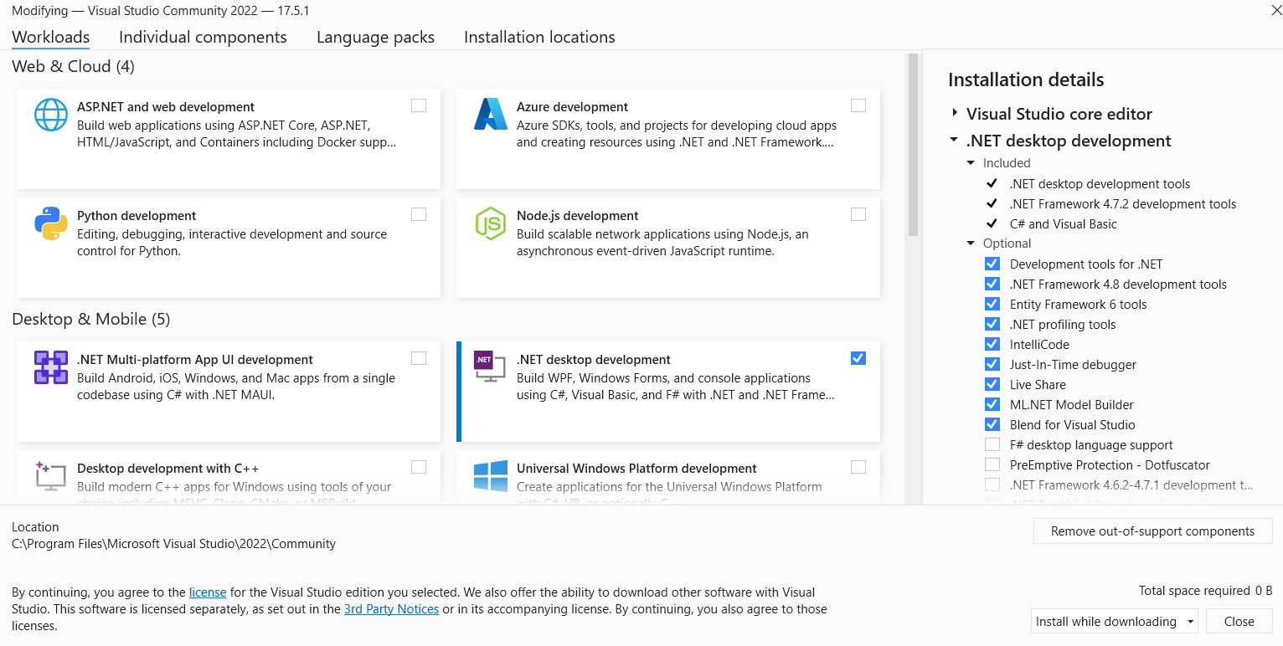

Slide 7
Getting Started – Terminology
What is a computer?
A device which processes information according to instructions it has been given.
The instructions you give to the computer are often called a program. The business of using a computer to create these instructions is often called programming.

Slide 8

Terminology
Data is the collection of ons and offs (1s and 0s) which computers store and manipulate.
Information is the interpretation of the data by people to mean something.
Strictly speaking computers process data, humans work on information.
As far as the computer is concerned data is just patterns of bits, it is the user who gives meaning to these patterns.

Slide 9
Terminology
Hardware is the physical side of the system.
Examples of hardware: CPU (central processing unit), RAM (random access memory), motherboard, mouse, monitor, graphics card
Software uses the physical ability of the hardware, which can run programs, to do something useful. It is called software because it has no physical existence.
Examples of software: Operating System (Windows, Mac OS, Linux), Chrome, Microsoft Word, Visual Studio

Slide 10
Terminology
A programming language is a system of notation for writing computer programs.
The description of a programming language is usually split into the two components of syntax (form) and semantics (meaning).
You will learn many different programming languages with different strengths and weaknesses created for different purposes.
C# — Application & Web Development
C/C++ — Operating Systems and System Tools
PHP — Web Development
SQL — Database Management
JavaScript — Interactive Web Development

Slide 11
C#
C# is a very flexible and powerful programming language with an interesting history. It was developed by Microsoft Corporation for a variety of reasons, some technical, some political and others marketing.
C# bears a strong resemblance to the C++ and Java programming languages, having borrowed (or improved) features provided by these languages. The origins of both Java and C++ can be traced back to a language called C.

Slide 12

More About C#
A C# program can contain managed or unmanaged parts.
The managed code is watched over by the system which runs it.
This makes sure that it is hard to crash your computer running managed code.
Causes your programs to run more slowly.
Unmanaged code enables direct access to parts of the underlying computer system to get the maximum possible performance.
An unmanaged program goes faster, but if it crashes it is capable of taking the computer.

Slide 13
C# - An object-oriented language
The C# language is object-oriented.
Objects are an organizational mechanism which let you break your program down into smaller pieces, each of which controls part of the overall system.
Object Oriented Design makes large projects much easier to design, test and extend.
It also lets you create programs which can have a high degree of reliability and stability.

Slide 14
C# - A compiled language
C# is a compiled programming language
The computer cannot understand the language directly, so a program called a compiler converts the C# text into the “low-level” instructions which are simpler for the computer to understand.
These low-level instructions are then converted into the actual commands to drive the hardware which runs your program.

Slide 15
Compilers
Compilers decide if a program is valid or not.
Check for errors in the way that you have used the language.
Shows warnings which occur when it notices that you have done something “wrong” and may indicate that you have made a mistake.
Examples of compiled languages: C#, Java, C++, Go

Slide 16

Interpreted Languages
In an interpreted language, the source code is not directly translated by the target machine. Instead, a different program, called the interpreter, reads and executes the code.
Examples of interpreted languages: Perl, Python, Ruby, PowerShell

